Slide 1
Developing Data Warehousing & Business Intelligence System
Company: Retail company

Slide 2
Company Profile
•Our organization is an American chain of discount variety stores proving Health and beauty, food and snacks, party, seasonal décor, housewares, etc. at discounted product range to customers.
• They have multiple database systems like Product, customer support databases, sales systems, etc.
• In addition, many areas of our business process are using spreadsheets to execute day to day business transactions which may be convenient but comes with multiple issues to manage and store data.
•The quarterly report generation requires all the data stored in multiple systems to have queried in order to extract meaningful business decision insights.
•As most of the work is manual, tedious, and error prone we ought to design a warehouse system for company

Slide 3
Proposed Solution
•The scattered data across multiple systems can be accumulated in a single place which will make data tracking handy.
•This single place where the scattered data will be stored is our proposed data warehouse.
•Through this design the system will be able to run automated, continuous, and error free reports in turn providing meaningful insights to our Business Intelligence activities and will make easier to take well informed decisions.
•The maintenance of past data in gain insights in form of historical trends can provide huge cost savings by implementation of smart cost-control measures.
•These combined benefits will enable our organization to manage long-term planning as well as help key personals to make the right business decisions with implementing concepts of BI in Data warehouse.

Slide 4
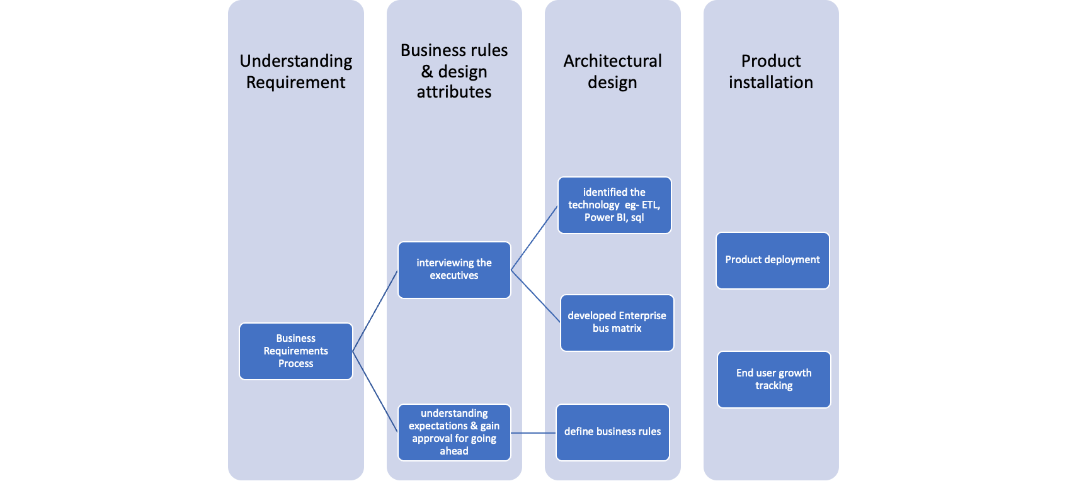
Business process & design lifecycle

Slide 5
Kimball methodology approach
There are two common methods for designing data warehouse, which are widely used. We selected Kimball which was most suitable
Kimball approach
A bottom-up approach was used after creating the bus matrix considering all the business processes, facts and dimension
Star schema was selected for the application of Kimball method as it will help us use a relational database for creating our data warehouse
Inmon Approach
Preferred for large-scale organisations, where each department has different purposes of data usage.
Needs more skills, money, and time to implement in comparison to Kimball
Not suitable for SMBs.

Slide 6
Enterprise Bus matrix
Business Processes | Date | Product | Invoice | Payment | Customer | Employee | Supplier unit
Sales | x | x | x | x | x | x
Forecast of sale | x | x | x
Warehouse inventory | x | x |  |  |  | x | x
Store inventory | x | x |  | x |  | x | x
Unit Price |  |  | x | x | x |  | x
Vendor Returns | x | x | x |  |  | x | x
Customer returns | x | x | x | x | x | x | x
Orders Purchase | x | x | x | x |  | x | x
Shipping | x | x | x | x | x

Slide 7
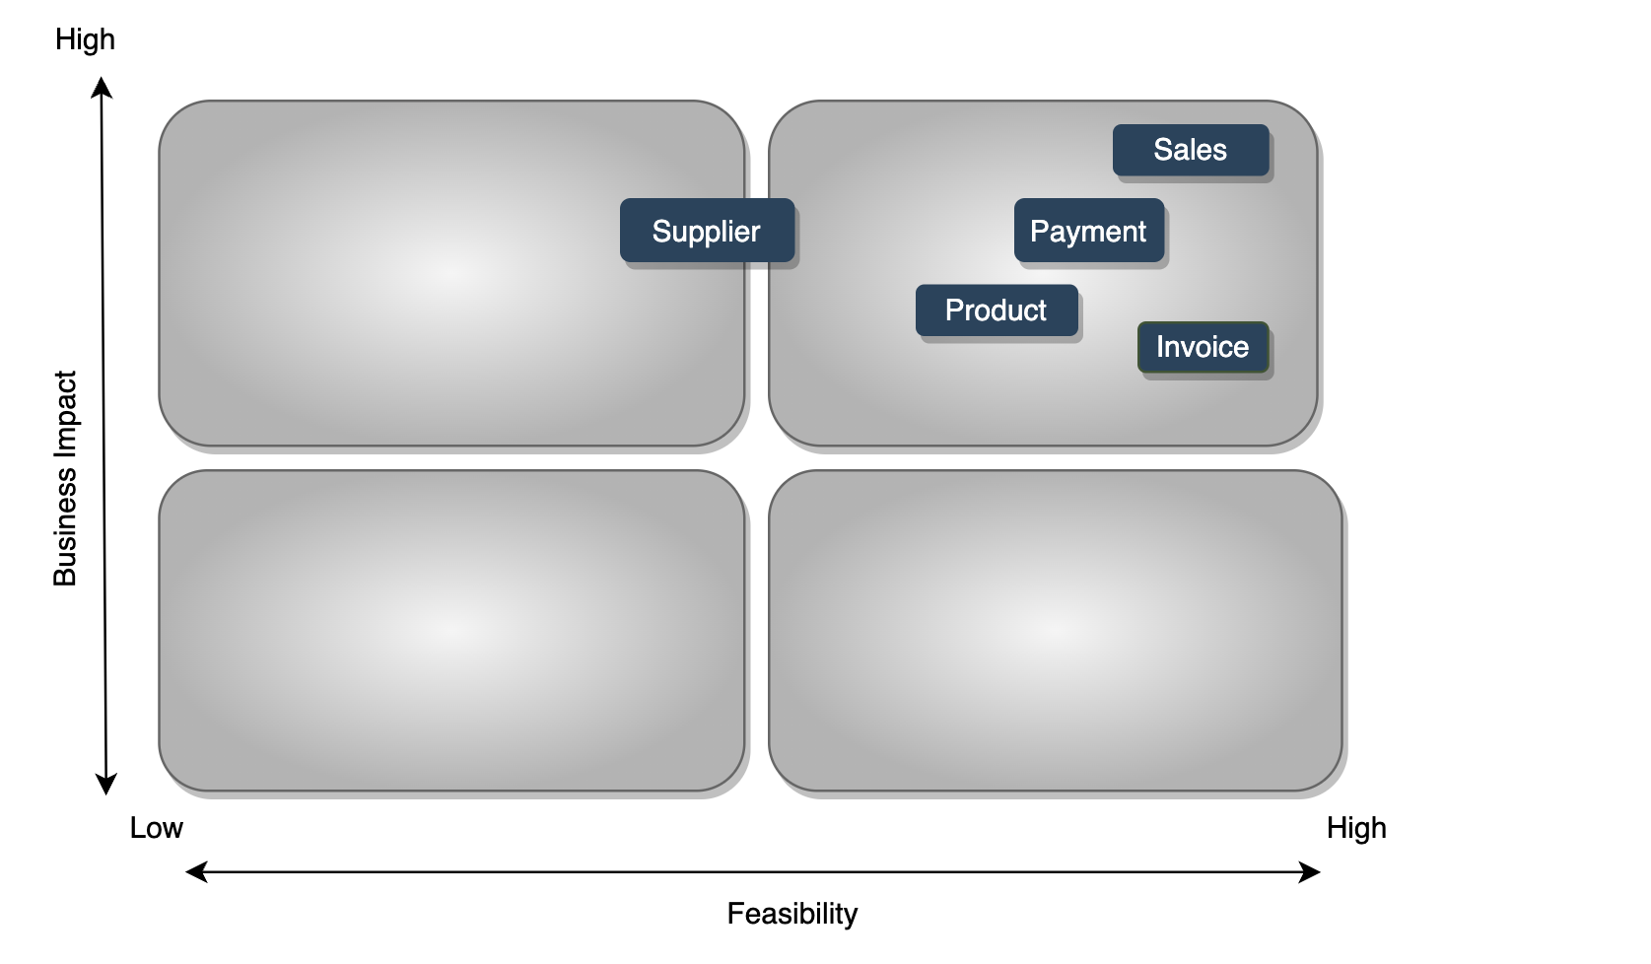
Prioritization Grid

Slide 8
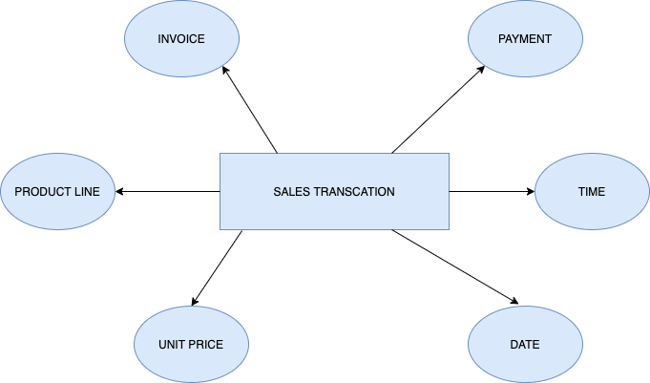
High Level Model Diagram

Slide 9
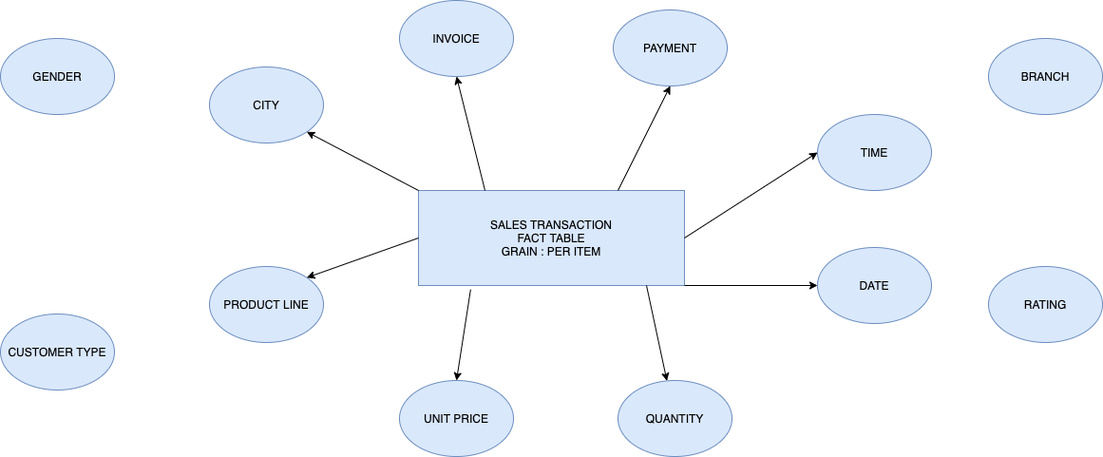
Logical Fact Table Diagram
Sales Fact Table diagram with connected and disconnected dimensions

Slide 10
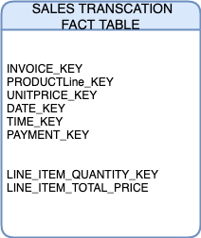
Detailed Fact Table
Fact table detail diagram showing dimension keys, Basic facts and derived facts
Dimensions are the foundation of the fact table, and is where the data for the fact table is collected
The grain of a fact table represents the most atomic level by which the facts may be defined

Slide 11
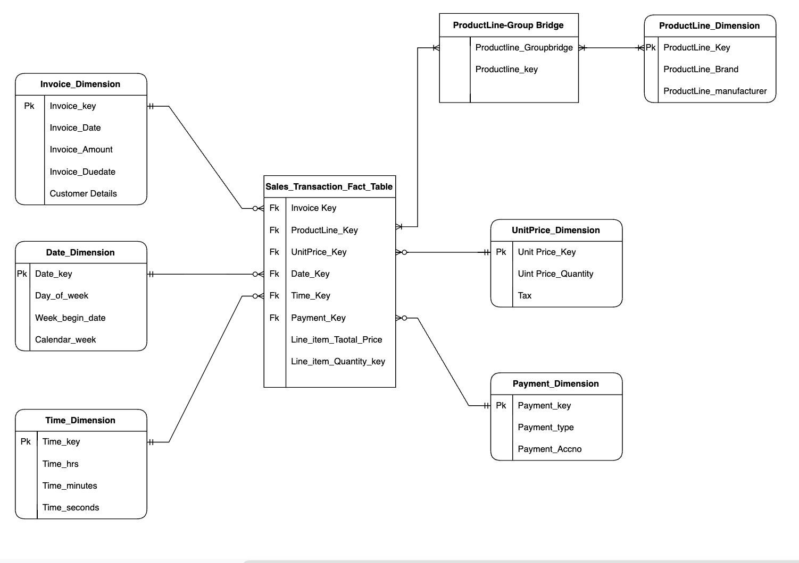
Star Schema for Sales_Transaction line item fact

Slide 12
Dimension Attribute Detailed Description - ProductLine_Key
Attribute Name | Attribute Description | Cardinality | Slowly Changing Dimension Policy | Sample Values
Number of product lines | Total number of product lines the company has | 10 | Type 4 | 10
Product mix | Total number of product lines a company offers to its customers | 6 | Type 2 | Clothing - Casual shirt, 3 varieties, 5 sizes, 2 colors
Cities | Name of Cities where the product line of company is operating | 532 | Type 1 (Overwritten) | Seattle, New York City, etc.
Distribution channel type | Type of distribution channel | 3 | Type 1 | Direct, Indirect, Hybrid
Distribution Channel intermediaries | Intermediaries who take products to customers | 9 | Type 1 | Retailers, wholesalers, etc.

Slide 13
Transformation Rules
Formatting:
Data types should be altered and standardized depending on their values
Splitting values:
To improve operating performance by indexing and analyzing individual components
Decoding fields:
Alters code into the values understandable by the end-users
Calculated and derived values/items:
Computing values/items before storing it in data warehouse
Merging information:
To establish connection between different values

Slide 14
Transformation Rules - Sales Transaction
Attributes | Types | Details
Sales Date and Time | Standardization | Date and time format should be same
Members names | Split single fields | Revise name format from First Name/Last Name → First Name/Middle Name/Last Name
Tax | Calculate values | 5% tax added to total price to calculate final cost
Total Cost | Calculate and Derive values | Sum of all costs, including tax, on all products
Currency | Calculate and Derive values | Revise the currency to local type

Slide 15
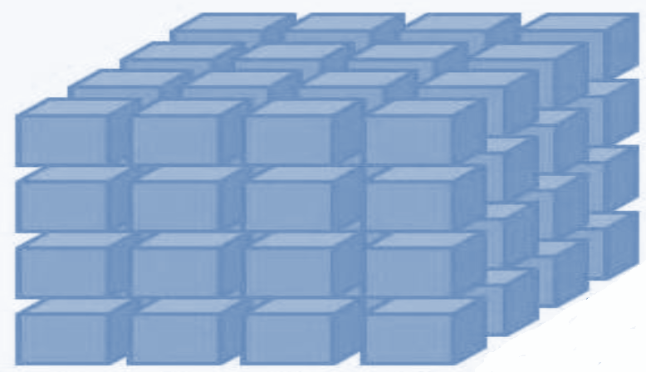
OLAP Cube
Product Line 1
Product Line 2
Product Line 3
Product Line 4
Month 1
Month 2
Month 3
Month 4
City 1
City 2
City 3
City 4

Slide 16
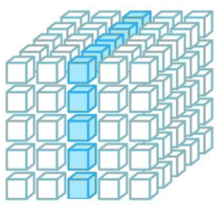
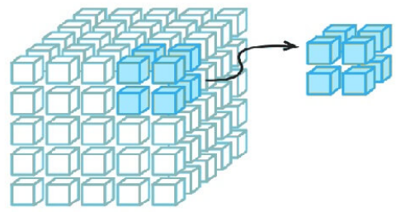
Slicing and Dicing
Slicing Dicing
Mar
Feb
Jan
Monday
Tuesday
Month
T-shirt
Formal
Food
Clothing
Beauty
Toys
Electronics
Product Line
Newark
Hoboken
FL LA NY TX NJ
City

Slide 17
Business Intelligence - Dashboards

Slide 18
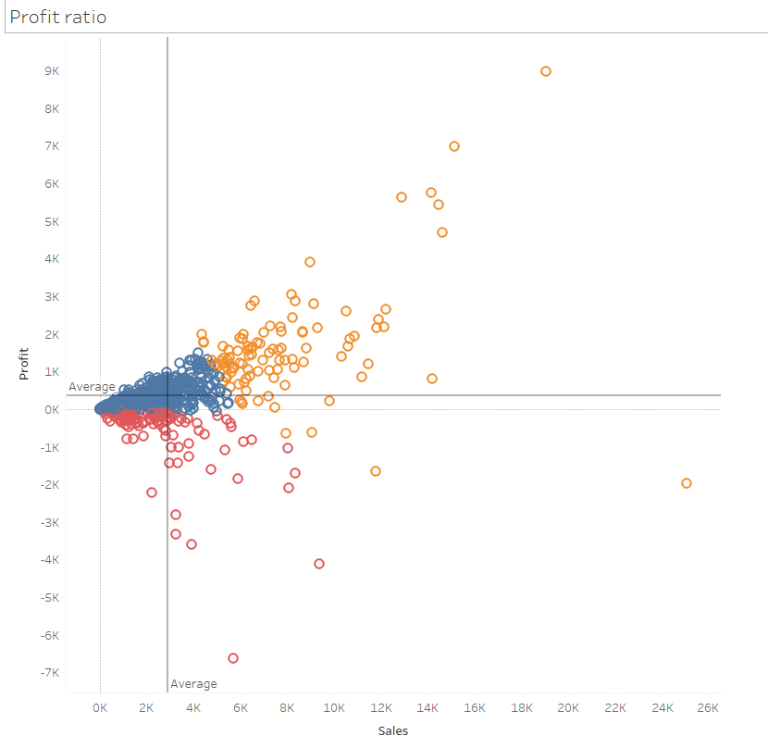

Slide 19
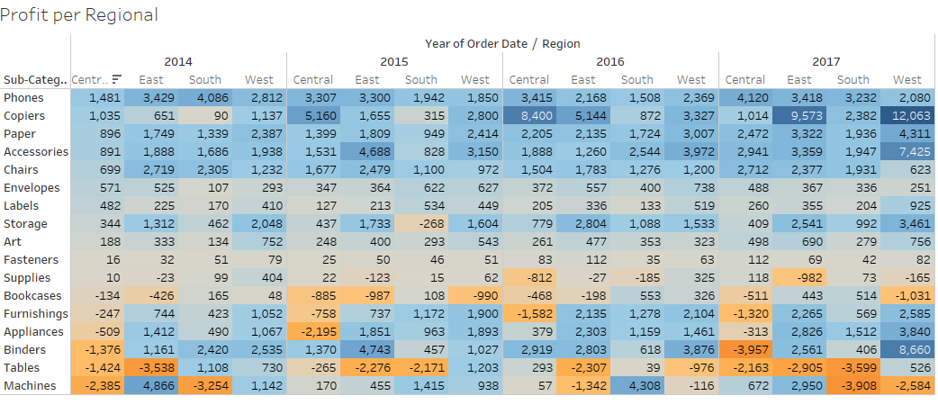

Slide 20
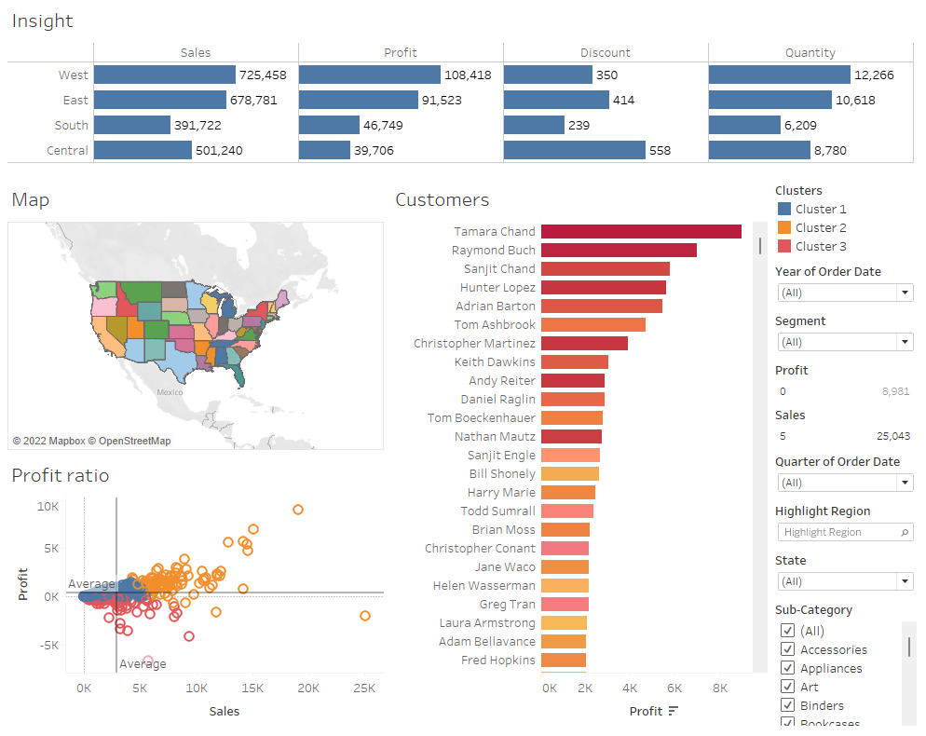

Slide 21
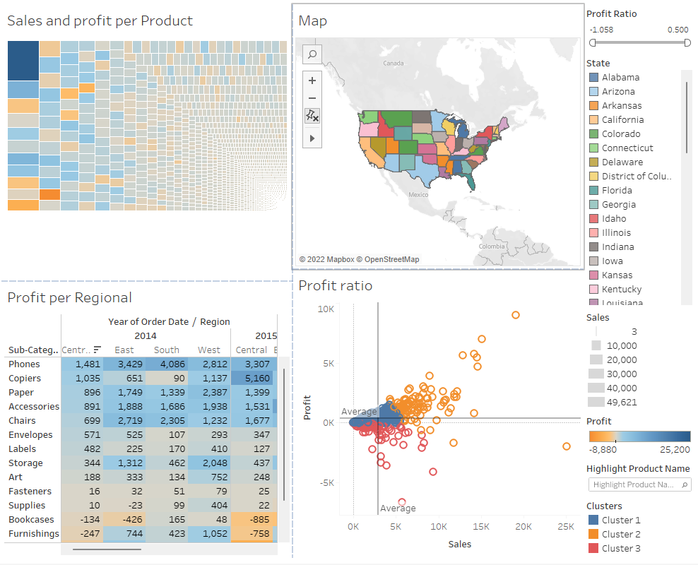

Slide 22
References
The Data Warehouse Toolkit The Definitive Guide to Dimensional Modeling Ralph Kimball, Margy Ross

